Slide 1



CSCI 476: Computer Security
Network Security: DNS Cache Poisoning
Reese Pearsall
Fall 2024
https://www.cs.montana.edu/pearsall/classes/fall2024/476/main.html

Slide 2
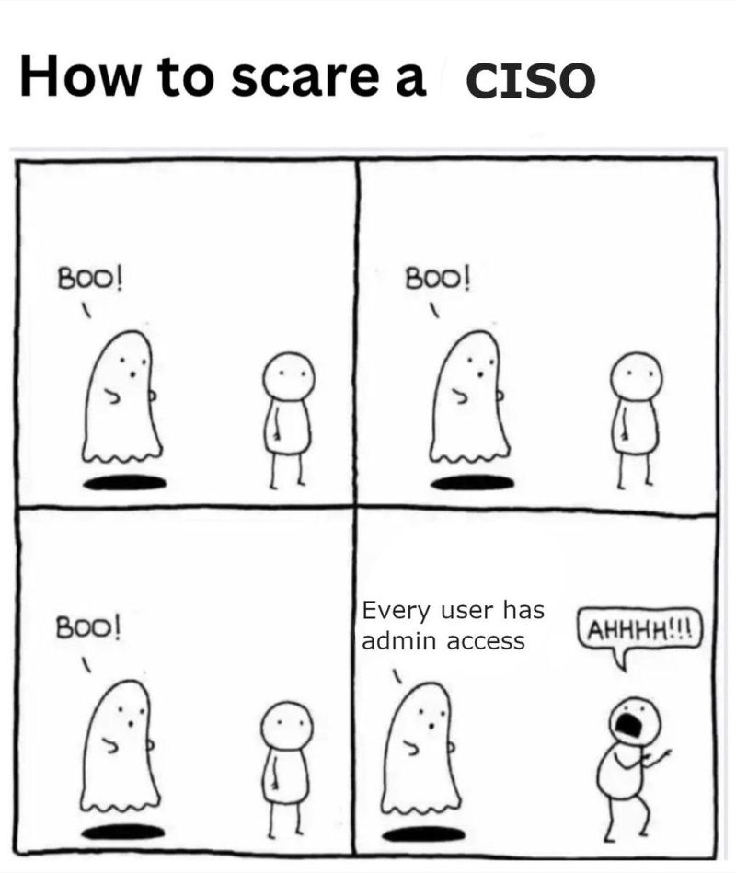
Announcement
CSCI 476 student
Lab 6 (TCP/IP Attacks) Due Sunday 11/3 @ 11:59 PM
Happy halloween

Slide 3
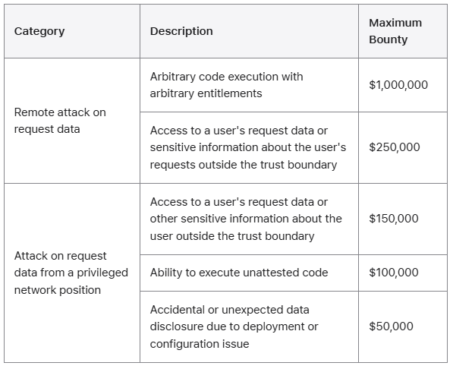
You can win one million dollars if you can get RCE on Apple’s private servers

Slide 4
Reverse Shell w/ Session Hijack Attack

Slide 5


When browsing the web, computers need the IP address of the host we are communicating with
Humans do not use IP addresses when using the internet, they use hostnames (English)
We need a way to go from hostnames to IP addresses
Humans browse the web using hostnames
(They need English)
Computers understand numbers
(They need IP addresses)
153.90.127.197

Slide 6
When browsing the web, computers need the IP address of the host we are communicating with
Humans do not use IP addresses when using the internet, they use hostnames (English)
We need a way to go from hostnames to IP addresses
Humans browse the web using hostnames
(They need English)
Computers understand numbers
(They need IP addresses)
DNS
153.90.127.197

Slide 7


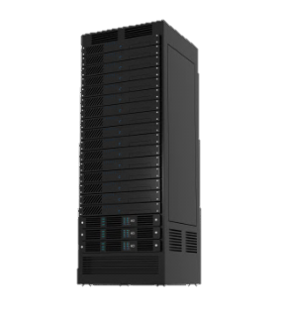

DNS Architecture
youtube.com
irs.gov
Clients will first need to resolve hostnames with DNS
montana.edu
3.
DNS
HTTP
1.
153.90.3.95
montana.edu ?
153.90.3.95
2.
Clients

Slide 8
DNS Architecture
youtube.com
irs.gov
montana.edu
DNS
DNS
DNS
.gov
.com
.edu
Clients

Slide 9
DNS Architecture
(how big would that map be?)
DNS is a distributed, hierarchical database (no DNS server has all the records!)
Hierarchy consists of different types of DNS servers:

Slide 10
DNS Architecture
(how big would that map be?)
DNS is a distributed, hierarchical database (no DNS server has all the records!)
Hierarchy consists of different types of DNS servers:
Authoritative DNS servers- Organization’s own DNS with up-to-date records
facebook.com DNS
amazon.com DNS
montana.edu DNS
harvard.edu DNS

Slide 11




DNS Architecture
(how big would that map be?)
DNS is a distributed, hierarchical database (no DNS server has all the records!)
Hierarchy consists of different types of DNS servers:
Authoritative DNS servers- Organization’s own DNS with up-to-date records
.com TLD DNS server
.edu TLD DNS server
Top-level domain (TLD) servers- responsible for keeping IP addresses for authoritative DNS servers for each top-level domain (.com, .edu, .jp, etc)
facebook.com DNS
amazon.com DNS
montana.edu DNS
harvard.edu DNS

Slide 12
DNS Architecture
(how big would that map be?)
DNS is a distributed, hierarchical database (no DNS server has all the records!)
Hierarchy consists of different types of DNS servers:
Authoritative DNS servers- Organization’s own DNS with up-to-date records
.com TLD DNS server
.edu TLD DNS server
Top-level domain (TLD) servers- responsible for keeping IP addresses for authoritative DNS servers for each top-level domain (.com, .edu, .jp, etc)
facebook.com DNS
amazon.com DNS
montana.edu DNS
harvard.edu DNS

Slide 13


DNS Architecture
(how big would that map be?)
DNS is a distributed, hierarchical database (no DNS server has all the records!)
Hierarchy consists of different types of DNS servers:
root DNS server
Authoritative DNS servers- Organization’s own DNS with up-to-date records
.com TLD DNS server
.edu TLD DNS server
Top-level domain (TLD) servers- responsible for keeping IP addresses for authoritative DNS servers for each top-level domain (.com, .edu, .jp, etc)
facebook.com DNS
amazon.com DNS
montana.edu DNS
harvard.edu DNS
Root DNS servers- responsible for maintaining IP addresses for TLD servers

Slide 14
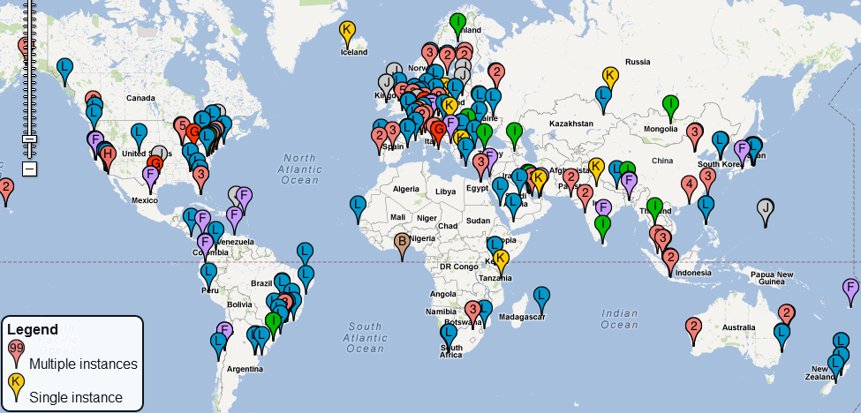
DNS Root server locations
https://root-servers.org/

Slide 15
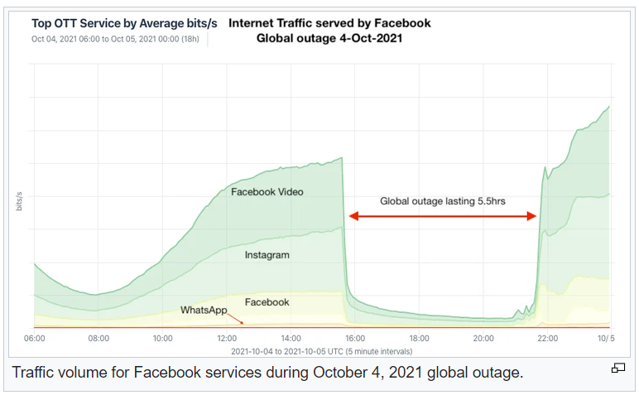

Slide 16
Domain Name System (DNS)
Application-level protocol used to map Domain Names to IP Addresses
DNS uses UDP as the transport layer protocol
No handshake
No guarantee that packet will arrive
DNS Packet
UDP Header
IP Header
Anatomy of a DNS Packet

Slide 17
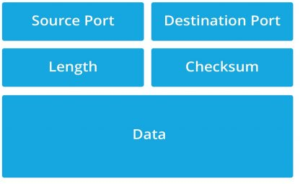


Domain Name System (DNS)
Application-level protocol used to map Domain Names to IP Addresses
DNS uses UDP as the transport layer protocol
No handshake
No guarantee that packet will arrive
UDP header Format
DNS Packet
UDP Header
IP Header
Anatomy of a DNS Packet

Slide 18
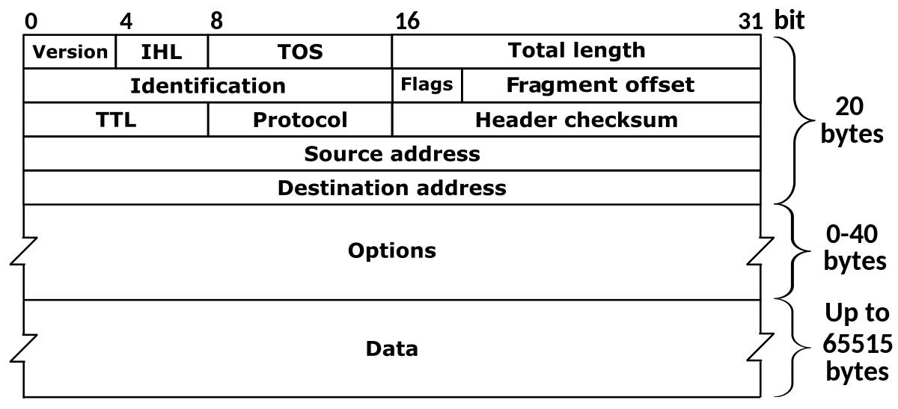


Domain Name System (DNS)
Application-level protocol used to map Domain Names to IP Addresses
DNS uses UDP as the transport layer protocol
No handshake
No guarantee that packet will arrive
DNS Packet
UDP Header
IP Header
Anatomy of a DNS Packet

Slide 19
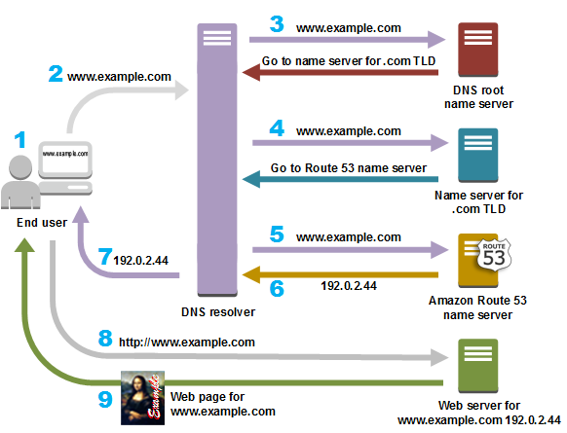
Suppose the user wants to go to www.example.com

Slide 20
Suppose the user wants to go to www.example.com
Step 0: The computer first checks its local cache to see if an entry exists

Slide 21

Suppose the user wants to go to www.example.com
Step 0: The computer first checks its local cache to see if an entry exists
Step 1: The user contacts a DNS resolver, which contacts a DNS root name server for the .com TLD

Slide 22

Suppose the user wants to go to www.example.com
Step 0: The computer first checks its local cache to see if an entry exists
Step 1: The user contacts a DNS resolver, which contacts a DNS root name server for the .com TLD
Step 2: The DNS resolver now contacts the .com TLD server, which returns the IP address of the example.com’s Authorative server

Slide 23




Suppose the user wants to go to www.example.com
Step 0: The computer first checks its local cache to see if an entry exists
Step 1: The user contacts a DNS resolver, which contacts a DNS root name server for the .com TLD
Step 2: The DNS resolver now contacts the .com TLD server, which returns the IP address of the example.com’s Authorative server
Step 3: The Authorative server gives us the IP address for www.example.com, and we can now send an HTTP request to that IP address!

Slide 24




Suppose the user wants to go to www.example.com
Step 0: The computer first checks its local cache to see if an entry exists
Step 1: The user contacts a DNS resolver, which contacts a DNS root name server for the .com TLD
Step 2: The DNS resolver now contacts the .com TLD server, which returns the IP address of the example.com’s Authorative server
Step 3: The Authorative server gives us the IP address for www.example.com, and we can now send an HTTP request to that IP address!
IMPORTANT
The user’s machine will now save the IP address for www.example.com in its cache

Slide 25
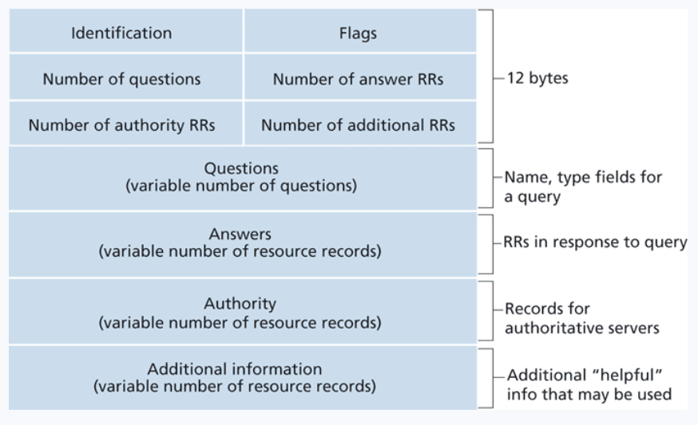
DNS Header
The domain name of the request
Ie. Google.com
If the IP address was found, it will go here
Contains records that point towards authoritative nameservers
Contains records that point towards authoritative nameservers

Slide 26
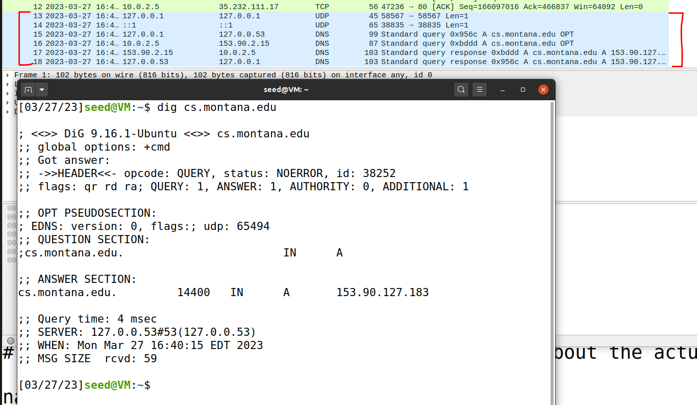

DNS In Wireshark
The dig command is used to issue DNS requests via the command line

Slide 27
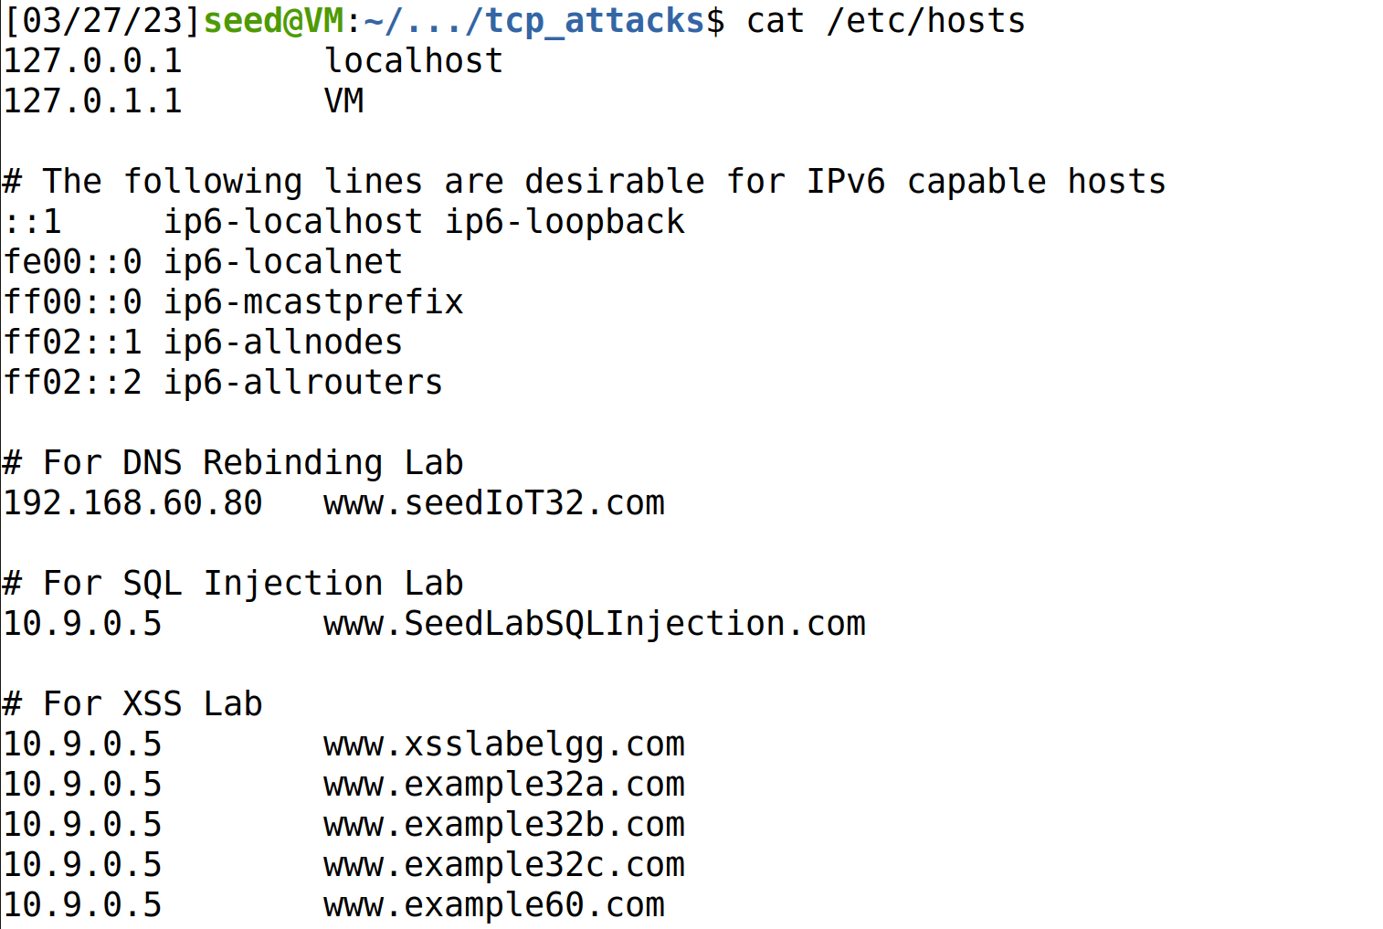
On Linux, the /etc/hosts holds static IP mappings for domain names
If we can compromise a machine, we can update /etc/hosts and inject IP address for malicious webpages

Slide 28
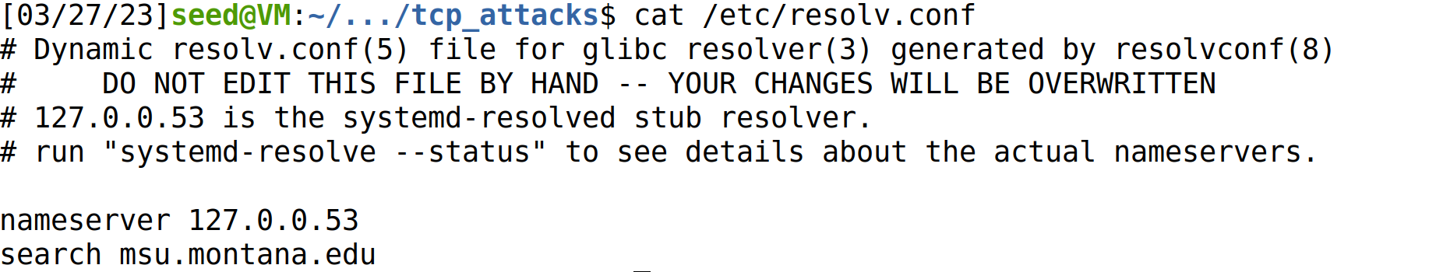
On Linux, the /etc/resolv.conf holds IP mappings for DNS server
If we can compromise a machine, we can update /etc/resolv.conf and inject IP address for malicious DNS servers**
**much more difficult

Slide 29
Attacks on the DNS protocol
When the user sends out a DNS request for a website they want to visit, they will have to wait for a response from a DNS server
This process of DNS resolving can take some time…
If an attacker wanted to cause some trouble, they could ???

Slide 30
Attacks on the DNS protocol
When the user sends out a DNS request for a website they want to visit, they will have to wait for a response from a DNS server
This process of DNS resolving can take some time…
If an attacker wanted to cause some trouble, they could spoof a packet to the user that has a malicious DNS response

Slide 31
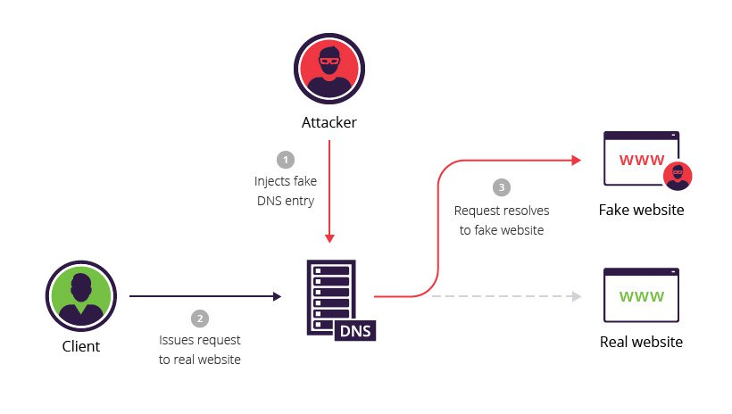
DNS Cache Poisoning Attack
A DNS cache poisoning attack is done by tricking a server into accepting malicious, spoofed DNS information
Instead of going to the IP address of the legitime website, they will go to the IP address that we place in our malicious DNS response (spoofed)
The DNS response is CACHED, which means the user will visit the malicious website in future visits**

Slide 32
DNS In Wireshark
The dig command is used to issue DNS requests via the command line

Slide 33
On Linux, the /etc/hosts holds static IP mappings for domain names
If we can compromise a machine, we can update /etc/hosts and inject IP address for malicious webpages

Slide 34
On Linux, the /etc/resolv.conf holds IP mappings for DNS server
If we can compromise a machine, we can update /etc/resolv.conf and inject IP address for malicious DNS servers**
**much more difficult

Slide 35




Lab Setup
Internet
We will once again use docker to setup our network environment
10.9.0.0/24
10.9.0.1
Attacker VM
10.9.0.5
Client Container
10.9.0.53
Local DNS Server
10.9.0.153
Attacker’s Nameserver (authoritative)
zone: attacker32.com
Because all these devices are on the same network (10.9.0.X), we can sniff their traffic!

Slide 36
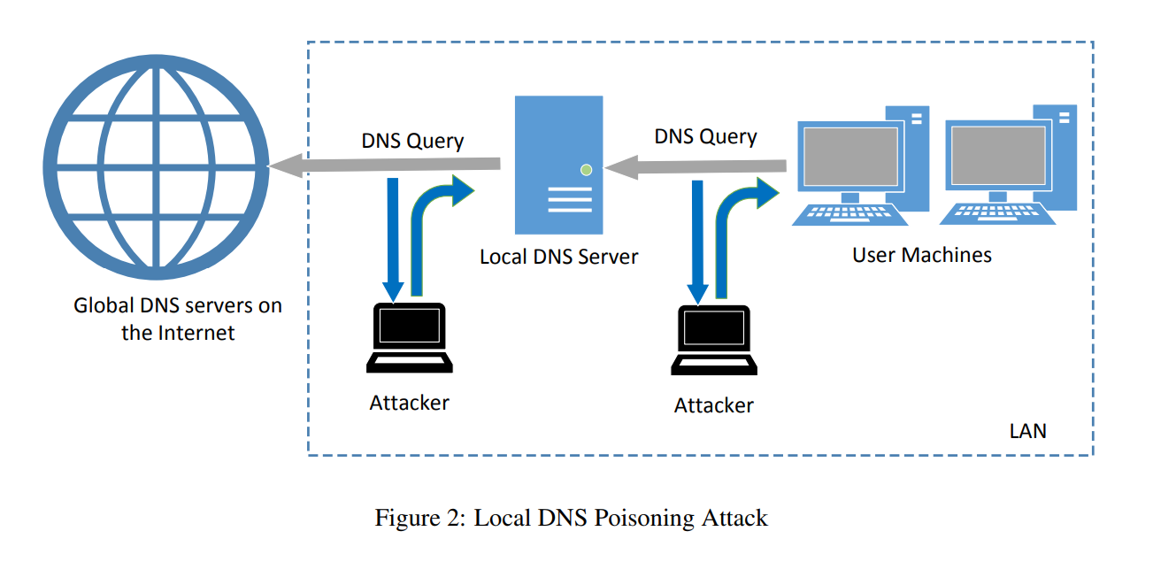
Attack Surface of DNS Poisoning
10.9.0.53
10.9.0.5
Cache
2
1
We have 2 options:
1. Send a spoofed DNS response packet to the client (10.9.0.5) that looks like it came from the local DNS server (10.9.0.53)
2. Send a spoofed DNS response packet to the local DNS server (10.9.0.53) that looks like it came from a global DNS server (????)

Slide 37

Spoofing a DNS response to a client (Task 1)
What is the IP address for example.com?
DNS Query
10.9.0.5
Client Container
10.9.0.53
Local DNS Server
Step 1. Sniff for DNS traffic going to the local DNS server

Slide 38

Spoofing a DNS response to a client (Task 1)
Internet
Waiting…
What is the IP address for example.com?
10.9.0.5
Client Container
10.9.0.53
Local DNS Server
DNS Query
Step 1. Sniff for DNS traffic going to the local DNS server
Step 2. Spoof a DNS response to the client with using information from the packet we sniffed!

Slide 39


Spoofing a DNS response to a client (Task 1)
Internet
Got a response!
What is the IP address for example.com?
10.9.0.5
Client Container
10.9.0.53
Local DNS Server
Spoofed DNS
Response
DNS Query
Step 1. Sniff for DNS traffic going to the local DNS server
Step 2. Spoof a DNS response to the client with using information from the packet we sniffed!
Step 3. The user receives a packet that looks like it came from the Local DNS server, and the client accepts the packet and uses the IP address

Slide 40
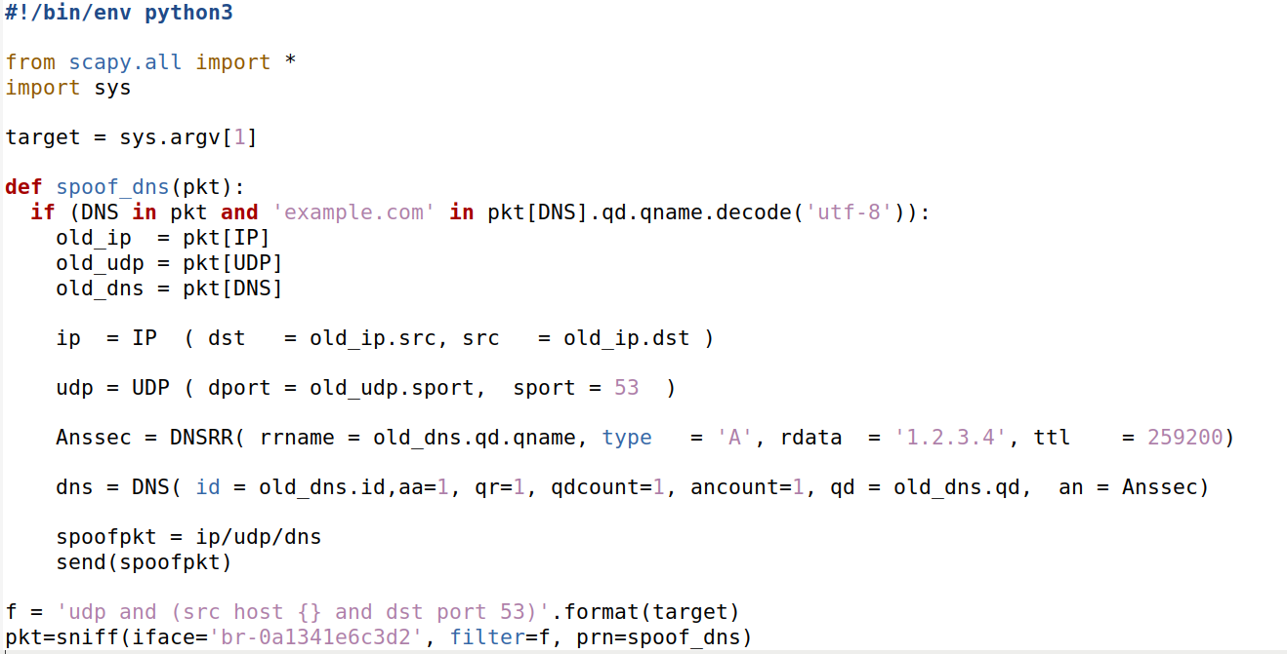
Spoofing a DNS Response Code
1
1. Sniff for DNS Traffic (Port 53)
You will need to change this value to match your network interface

Slide 41
Spoofing a DNS Response Code
2
2. We sniff for DNS traffic that has a SRC IP address of <command_line_argument>
1
1. Sniff for DNS Traffic (Port 53)
You will need to change this value to match your network interface

Slide 42
Spoofing a DNS Response Code
2
2. We sniff for DNS traffic that has a SRC IP address of <command_line_argument>
3
3. Pull the IP, port, and DNS information from the sniffed packet
1
1. Sniff for DNS Traffic (Port 53)
You will need to change this value to match your network interface

Slide 43
Spoofing a DNS Response Code
2
2. We sniff for DNS traffic that has a SRC IP address of <command_line_argument>
3
3. Pull the IP, port, and DNS information from the sniffed packet
4. Fill in fields for the IP header, UDP header, and DNS header
4
1
1. Sniff for DNS Traffic (Port 53)
You will need to change this value to match your network interface

Slide 44
Spoofing a DNS Response Code
2
2. We sniff for DNS traffic that has a SRC IP address of <command_line_argument>
3
3. Pull the IP, port, and DNS information from the sniffed packet
4. Fill in fields for the IP header, UDP header, and DNS header
4
5
5. Instead of the actual IP address of example.com, our spoofed DNS response will tell the user that the IP address is 1.2.3.4 (malicious IP)
1
1. Sniff for DNS Traffic (Port 53)
You will need to change this value to match your network interface

Slide 45
Spoofing a DNS Response Code
Attacker VM (10.9.0.1)
1. On the attacker VM, run the sniff/spoof python script
(make sure you changed the network interface in the script)

Slide 46
Spoofing a DNS Response Code
Attacker VM (10.9.0.1)
Local DNS Sever (10.9.0.53)
1. On the attacker VM, run the sniff/spoof python script
2. docksh into the local DNS server container and flush the cache

Slide 47
Spoofing a DNS Response Code
Attacker VM (10.9.0.1)
Local DNS Sever (10.9.0.53)
Victim Container (10.9.0.5)
1. On the attacker VM, run the sniff/spoof python script
2. docksh into the local DNS server container and flush the cache
3. docksh into the victim container and run the dig command to send a DNS query for example.com

Slide 48
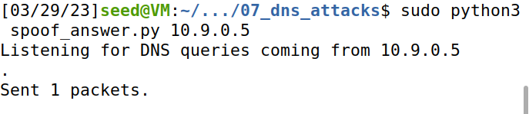
Spoofing a DNS Response Code
Attacker VM (10.9.0.1)
Local DNS Sever (10.9.0.53)
Victim Container (10.9.0.5)
1. On the attacker VM, run the sniff/spoof python script
2. docksh into the local DNS server container and flush the cache
3. docksh into the victim container and run the dig command to send a DNS query for example.com
4. Our sniffer picks up the DNS query, and spoofs a response to the Victim
“The IP Address for example.com is 1.2.3.4”

Slide 49
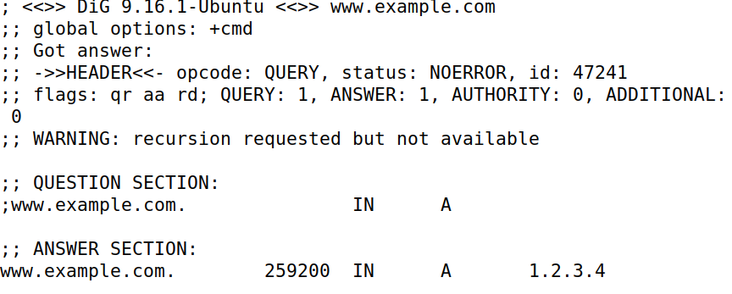


Spoofing a DNS Response Code
Attacker VM (10.9.0.1)
Local DNS Sever (10.9.0.53)
Victim Container (10.9.0.5)
1. On the attacker VM, run the sniff/spoof python script
2. docksh into the local DNS server container and flush the cache
3. docksh into the victim container and run the dig command to send a DNS query for example.com
4. Our sniffer picks up the DNS query, and spoofs a response to the Victim
5. The response of our Dig command should be 1.2.3.4
(the malicious IP that came from our spoofed packet)!
“The IP Address for example.com is 1.2.3.4”

Slide 50


Spoofing a DNS Response Code
Instead of going to the actual IP address for example.com (93.184.216.34), they will now go to the malicious IP address from the spoofed packet (1.2.3.4) which is an IP address the attacker controls!!
Attacker VM (10.9.0.1)
Local DNS Sever (10.9.0.53)
Victim Container (10.9.0.5)
1. On the attacker VM, run the sniff/spoof python script
2. docksh into the local DNS server container and flush the cache
3. docksh into the victim container and run the dig command to send a DNS query for example.com
4. Our sniffer picks up the DNS query, and spoofs a response to the Victim
5. The response of our Dig command should be 1.2.3.4
(the malicious IP that came from our spoofed packet)!
(We won’t design this evil website, but it really could be anything we want (we control it!) )
“The IP Address for example.com is 1.2.3.4”

Slide 51

Spoofing a DNS response to the local DNS server (Task 2)
Internet
Waiting…
Cache
What is the IP address for example.com?
10.9.0.5
Client Container
10.9.0.53
Local DNS Server
DNS Query
Step 1. Sniff for outgoing DNS traffic from the local DNS server

Slide 52

Spoofing a DNS response to the local DNS server (Task 2)
Internet
Waiting…
Waiting…
Cache
10.9.0.5
Client Container
10.9.0.53
Local DNS Server
“The IP Address for example.com is 1.2.3.4”
Step 1. Sniff for outgoing DNS traffic from the local DNS server
Step 2. Using information from the sniffed packet, spoof a packet to the Local DNS server that looks like the packet came from a Global DNS server

Slide 53

Spoofing a DNS response to the local DNS server (Task 2)
Internet
Got a response!
Got a response!
Cache
10.9.0.5
Client Container
10.9.0.53
Local DNS Server
“The IP Address for example.com is 1.2.3.4”
Step 1. Sniff for outgoing DNS traffic from the local DNS server
Step 2. Using information from the sniffed packet, spoof a packet to the Local DNS server that looks like the packet came from a Global DNS server
Step 3. The Local DNS Server accepts packet and caches it and send a DNS response to the client

Slide 54
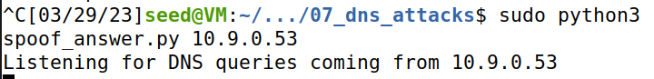
We use the exact same program, but we sniff for a different IP address now (10.9.0.53)

Slide 55


Our attack method is the exact same, except we sniff for a different IP address
Spoofing a DNS Response packet to the LOCAL DNS Server
Attacker VM (10.9.0.1)
Local DNS Sever (10.9.0.53)
Victim Container (10.9.0.5)
1. On the attacker VM, run the sniff/spoof python script
2. docksh into the local DNS server container and flush the cache
3. docksh into the victim container and run the dig command to send a DNS query for example.com
4. Our sniffer picks up the DNS query, and spoofs a response to the Victim
5. The response of our Dig command should be 1.2.3.4
(the malicious IP that came from our spoofed packet)!
“The IP Address for example.com is 1.2.3.4”

Slide 56
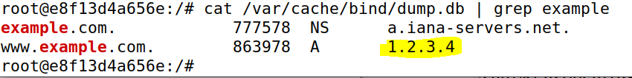

Spoofing a DNS Response packet to the LOCAL DNS Server
Local DNS Sever (10.9.0.53)
Cache
Important: When we attack the Local DNS Sever, our spoofed DNS response gets cached by the DNS server
Whenever someone asks this local DNS server for the IP address of example.com, it will always return 1.2.3.4 right away
We have “poisoned” this DNS server

Slide 57




Spoofing a DNS Response packet to the LOCAL DNS Server
Local DNS Sever (10.9.0.53)
Cache
DNS Servers hold DNS Records
Type A Records: IPv4 Addresses. Ie. the IP Address for www.example.com is 1.2.3.4
Type NS Records: Authoritative DNS Servers for a domain. Ie. the Authoritative DNS Server for www.example.com is a.iana-servers.net

Slide 58

Spoofing a DNS Response packet to the LOCAL DNS Server
Local DNS Sever (10.9.0.53)
Cache
DNS Servers hold DNS Records
Type A Records: IPv4 Addresses. Ie. the IP Address for www.example.com is 1.2.3.4
Type NS Records: Authoritative DNS Servers for a domain. Ie. the Authoritative DNS Server for www.example.com is a.iana-servers.net
Other types:
Type AAA: IPv6 Address
Type CNAME: “Canonical name” aka an alias for another domain

Slide 59
Spoofing a DNS Response packet to the LOCAL DNS Server
Local DNS Sever (10.9.0.53)
Cache
DNS Servers hold DNS Records
Type A Records: IPv4 Addresses. Ie. the IP Address for www.example.com is 1.2.3.4
Type NS Records: Authoritative DNS Servers for a domain. Ie. the Authoritative DNS Server for www.example.com is a.iana-servers.net
Our next text will be to poison a local DNS cache with NS type records.
→ Visitor that want to access any webpage in the domain example.com will use the attackers nameserver

Slide 60
Spoofing NS Records (Task 3)
Real nameserver for example.com
www.blah.example.com
DNS Queries
Cache
10.9.0.53
Local DNS Server
10.9.0.153
Attacker’s Nameserver (authoritative)
zone: attacker32.com
www.products.example.com
DNS Records on 10.9.0.53 (the “cache”)
www.safe.example.com
example.com | NS | attacker32.com
www.reese.com | A | 5.6.7.8
Facebook.com | NS | 192.68.7.223
We must contact the example.com authoritative nameserver to get the IP address. If we poison the local DNS server with malicious NS records, it will use the attackers nameserver

Slide 61
Spoofing NS Records (Task 3)
Real nameserver for example.com
www.blah.example.com
DNS Queries
Cache
1.2.3.4
10.9.0.53
Local DNS Server
10.9.0.153
Attacker’s Nameserver (authoritative)
zone: attacker32.com
www.products.example.com
1.2.3.4
DNS Records on 10.9.0.53 (the “cache”)
www.safe.example.com
example.com | NS | attacker32.com
www.reese.com | A | 5.6.7.8
Facebook.com | NS | 192.68.7.223
1.2.3.4
We must contact the example.com authoritative nameserver to get the IP address. If we poison the local DNS server with malicious NS records, it will use the attackers nameserver

Slide 62
Spoofing NS Records
Attacker VM (10.9.0.1)
Local DNS Sever (10.9.0.53)
Victim Container (10.9.0.5)
1. Flush the Local DNS Cache

Slide 63
Spoofing NS Records
Attacker VM (10.9.0.1)
Local DNS Sever (10.9.0.53)
Victim Container (10.9.0.5)
2. Run Python script that will sniff and spoof DNS responses
1. Flush the Local DNS Cache

Slide 64
Spoofing NS Records
Attacker VM (10.9.0.1)
Local DNS Sever (10.9.0.53)
Victim Container (10.9.0.5)
3. Run dig command to generate DNS traffic
2. Run Python script that will sniff and spoof DNS responses
1. Flush the Local DNS Cache

Slide 65
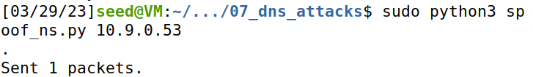
Spoofing NS Records
Attacker VM (10.9.0.1)
Local DNS Sever (10.9.0.53)
Victim Container (10.9.0.5)
3. Run dig command to generate DNS traffic
2. Run Python script that will sniff and spoof DNS responses
1. Flush the Local DNS Cache
4. Our sniffer program detects a new DNS query, and spoofs an NS response

Slide 66
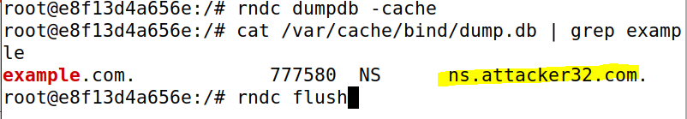

Spoofing NS Records
Attacker VM (10.9.0.1)
Local DNS Sever (10.9.0.53)
Victim Container (10.9.0.5)
3. Run dig command to generate DNS traffic
2. Run Python script that will sniff and spoof DNS responses
1. Flush the Local DNS Cache
5. Check the cache on the local DNS server
4. Our sniffer program detects a new DNS query, and spoofs an NS response
Whenever somebody contacts a domain under example.com, it will use the attacker’s nameserver!!

Slide 67

Remote DNS servers?
Packet spoofing countermeasures?
Coming soon ™
67

Slide 68
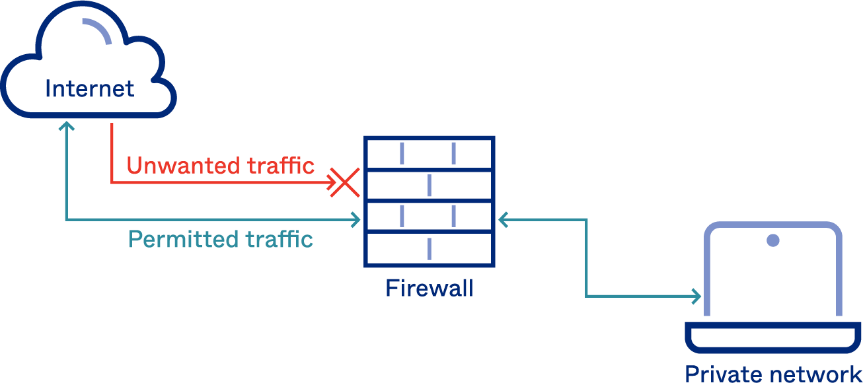
A firewall is a part of a computer system or network that is designed to
stop unauthorized traffic from one network to another.
All traffic must “pass” through the firewall
Only authorized traffic should be allowed to pass through
The firewall itself must be immune to penetration

Slide 69


A firewall is a part of a computer system or network that is designed to
stop unauthorized traffic from one network to another.
All traffic must “pass” through the firewall
Only authorized traffic should be allowed to pass through
The firewall itself must be immune to penetration
Packets are analyzed by the Firewall, and are:
Accepted
Denied/Dropped
Rejected (source of packet gets a rejection message)

Slide 70
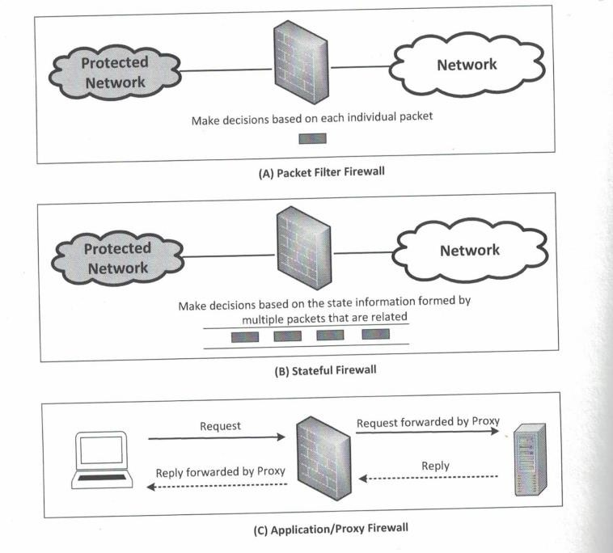
Three types of firewalls
Packet Filter
→ Makes decisions based on information within packet (IP address, port #s, etc)
Stateful Firewall
→ Makes decisions based “sessions” and streams of related packets
Application/Proxy Firewall
→ Can inspect traffic at many layers of the OSI
model
→ Acts as a middleman between sender and recipient
→ Proxy can handle authentication, which can prevent IP spoofing attacks on the server

Slide 71
Implementing a Firewall in Linux
Linux has a built-in Firewall that we can play around with, called iptables
Iptables consists of three tables, and tables consist of chains (rules)
Table Name | Purpose
filter | Packet Filtering
nat | Modifying source or destination network address
mangle | Packet content modification
We will only focus on the filter table

Slide 72






Implementing a Firewall in Linux
Tables consist of chains (rules)
Three types of chains:
Input
INPUT-
OUTPUT-
traffic
FORWARD-
traffic
rule for incoming traffic rule for outgoing
rule for forwarding
Output
Forward

Slide 73


Implementing a Firewall in Linux
Tables consist of chains (rules)
We can add a rule to a chain by following this format
iptables –t filter –A input <rule information>
Add rule to filter table (if table name is not provided, filter will be used by default)
Rule is getting Appended to the input chain, which means it’s a rule for incoming traffic

Slide 74
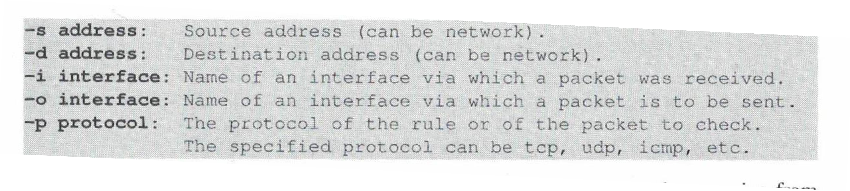
Implementing a Firewall in Linux
iptables –t filter –A input
<rule information>
We can provide a variety of flags to provide rule information
Putting this all together, we can now add a rule:
iptables –t filter –A INPUT –s 192.168.60.6 –j ACCEPT

Slide 75
Implementing a Firewall in Linux
iptables –t filter –A input
<rule information>
We can provide a variety of flags to provide rule information
Putting this all together, we can now add a rule:
iptables –t filter –A INPUT –s 192.168.60.6 ACCEPT
Add a rule for incoming traffic to the filter table: accept packets that have a source IP
–j
address of 192.168.60.6
(There is a default rule to accept everything for all chains, so this doesn’t really do anything…)

Slide 76
Implementing a Firewall in Linux
iptables –t filter –A input <rule information> -j action
We can provide a variety of flags to provide rule information
Putting this all together, we can now add a rule:
iptables –t filter –A INPUT –s 10.9.0.1 –j DROP
Block (drop) all incoming traffic that comes from 10.9.0.1 (The attacker VM!!)

Slide 77
Implementing a Firewall in Linux
iptables –t filter –A input <rule information> -j action
We can provide a variety of flags to provide rule information
Putting this all together, we can now add a rule:
iptables –t filter –A OUTPUT –d 10.9.0.1 –j DROP
Block (drop) all outgoing traffic that is going to 10.9.0.1 (The attacker VM!!)
46

Slide 78
Implementing a Firewall in Linux
iptables –t filter –A input <rule information> -j action
We can provide a variety of flags to provide rule information
Putting this all together, we can now add a rule:
iptables –t filter –A INPUT –p tcp –j DROP
Block all incoming traffic that is using the TCP protocol

Slide 79
Implementing a Firewall in Linux
iptables –t filter –A input <rule information> -j action
We can provide a variety of flags to provide rule information
Putting this all together, we can now add a rule:
iptables –t filter –A INPUT –p tcp –j DROP
Block all incoming traffic that is using the TCP protocol
This will help prevent TCP flooding/reset/hijack…
but this rule is a very
bad idea

Slide 80
Implementing a Firewall in Linux
iptables –t filter –A input <rule information> -j action
We can provide a variety of flags to provide rule information
Putting this all together, we can now add a rule:
iptables –t filter –A INPUT
–i eth0 -p tcp –-dport 443
–j ACCEPT
We can have multiple conditions in one rule:
Accept all incoming traffic on the eth0 interface and is TCP traffic for destination port 443 (???)

Slide 81
Implementing a Firewall in Linux
iptables –t filter –A input <rule information> -j action
We can provide a variety of flags to provide rule information
Putting this all together, we can now add a rule:
iptables –t filter –A INPUT
–i eth0 -p tcp –-dport 443
–j ACCEPT
We can have multiple conditions in one rule:
Accept all incoming traffic on the eth0 interface and is TCP traffic for destination port 443 (HTTPS)
50

Slide 82
Implementing a Firewall in Linux
iptables –t filter –A input <rule information> -j action
We can provide a variety of flags to provide rule information
Putting this all together, we can now add a rule:
iptables -A OUTPUT -o eth0 -p tcp --dport 22 -j ACCEPT
iptables -A INPUT -i eth0 -p tcp --sport 22 -j ACCEPT
Allow for SSH connections (port 22)

Slide 83
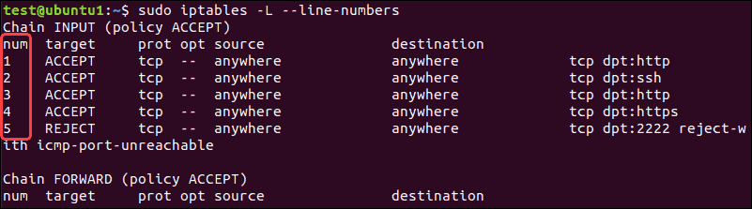
Implementing a Firewall in Linux
We can use iptables –n –L to view our tables + chains
Rules at the top of the chain have higher priority. If a packet matches one of the rules, it won’t check the remaining rules
(so, it is very common practice to move around rules in the chain)

